Slide 1
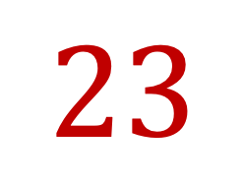




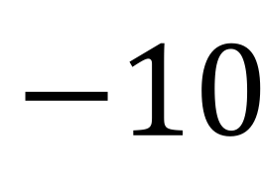


Topic: Surds EQ: How do we apply basic operations to surds?
$$+$$
$$23$$
-1
$$−$$
$$×$$
$$÷$$
Name:
Class:
Teacher:
Semester 1
Term 1
$$5^{2}$$
$$0$$
$$−10$$

Slide 2

Interactive Notebooks!
Cover Page
Contents Page
Glossary
24/7/30
EQ
Questions
Notes
Summaries
Work page
Presentation!!!
Your book, your responsibility!

Slide 3


Slide 4
























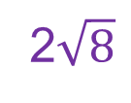
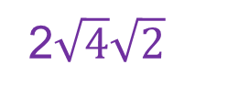
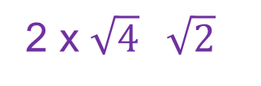
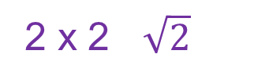
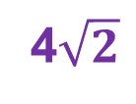
Starter
TASK
Simplify the following surds:
1)
2)
3)
4)
5)
6)
7)
=
=
=
=
=
=
=
=
=
=
=
=
=
=
EXTENSION
=
=
=
=
x
=
x
=

Slide 5
24
7
30
Surds
Date
EQ – How do we apply basic operations to surds?
Summary:

Slide 6
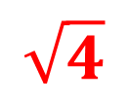
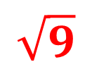
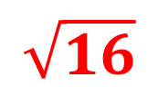
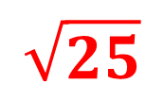
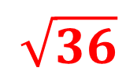
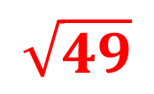
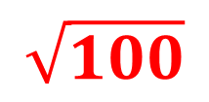













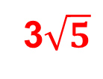







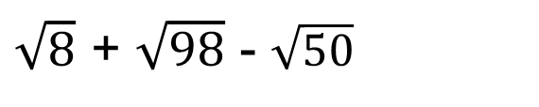
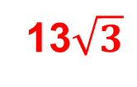
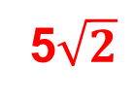










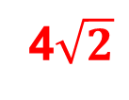
Which ones are you using?
Creative Thinker
Effective Participator
Independent Enquirer
Reflective Learner
Self Manager
Team Worker
PLT Skills
SUMS WITH SURDS
LEARN THESE OFF BY HEART
EXAMPLES
Simplify the following surds:
(a)
(b)
(c)
(d)
=
=
=
=
=
=
(e)
=
=
=
=
=
Notes:
6

Slide 7





















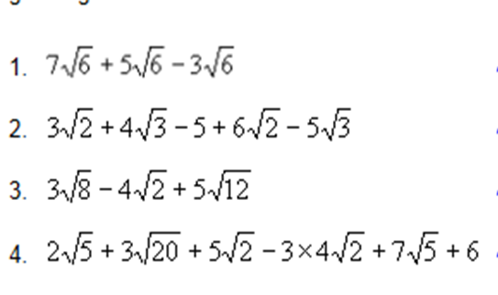
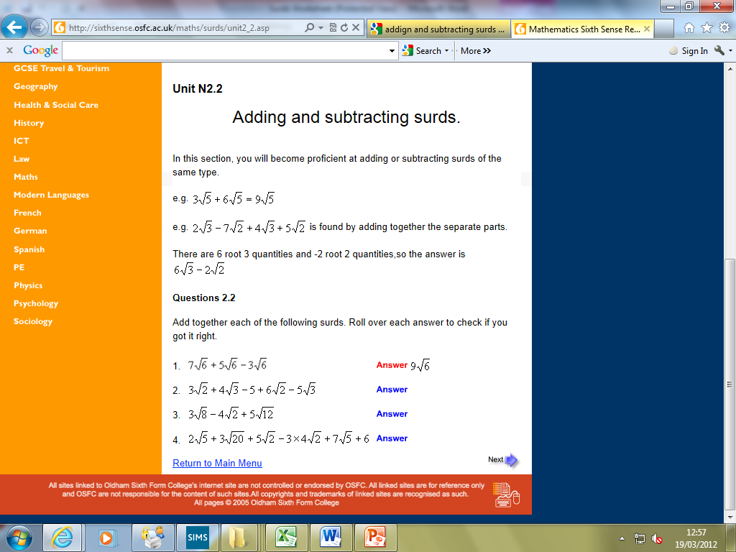




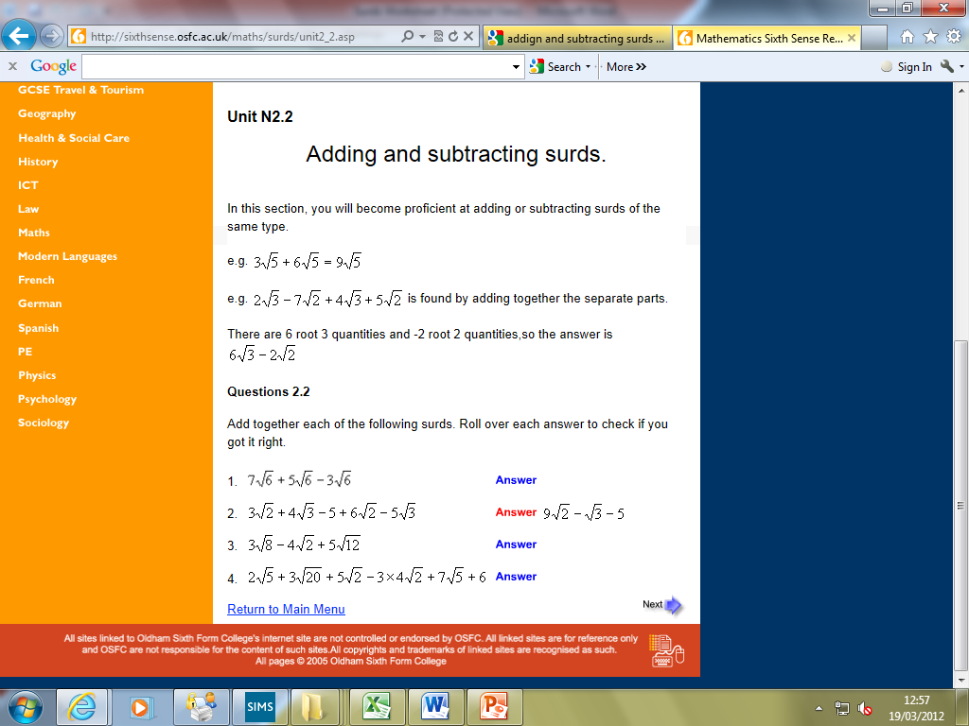









Which ones are you using?
Creative Thinker
Effective Participator
Independent Enquirer
Reflective Learner
Self Manager
Team Worker
PLT Skills
SUMS WITH SURDS
TASK 1
TASK 3
Simplify:
Simplify:
1)
1)
2)
2)
3)
3)
4)
4)
5)
5)
= 16
6)
EXTENSION
TASK 2
Simplify:
Simplify:
1)
=
1)
2)
2)
=
3)
3)
=
4)
5)
=
4)
Notes:
7

Slide 8
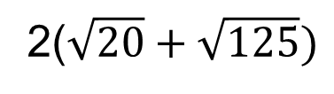










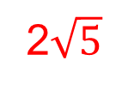

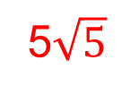



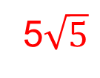
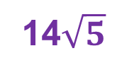
Which ones are you using?
Creative Thinker
Effective Participator
Independent Enquirer
Reflective Learner
Self Manager
Team Worker
PLT Skills
SUMS WITH SURDS
MINI-PLENARY
Simplify the following surd:
=
=
=
=
Notes:
8

Slide 9










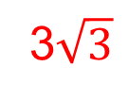





PLENARY ACTIVITY
Simplify fully:
You must show your working.
=
=
=
=
2

Slide 10
24
7
30
Surds
Date
EQ – How do we apply basic operations to surds?

Slide 11























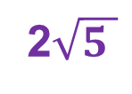

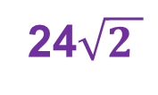
Which ones are you using?
Creative Thinker
Effective Participator
Independent Enquirer
Reflective Learner
Self Manager
Team Worker
PLT Skills
SIMPLIFYING SURDS
LEARN THESE OFF BY HEART
EXAMPLES
Simplify each of these following surds fully:
(a)
x
(b)
x
(c)
÷
(d)
÷
x
x
6
20
5
3
x
x
2
3
=
=
x
x
=
=
4
3
=
15
x
=
6
x
=
2
x
=
5
x
=
=
6
x
=
=
5
x
4
6
x
=
4
=
20
=
Notes:
11

Slide 12
Which ones are you using?
Creative Thinker
Effective Participator
Independent Enquirer
Reflective Learner
Self Manager
Team Worker
PLT Skills
SIMPLIFYING SURDS
Write each of the following surds in their simplest form:
TASK 1
TASK 2
TASK 3
EXTENTION
a) 2√18 × 3√2
b) 4√24 × 2√5
c) 3√12 × 3√3
d) 2√8 × 2√8
e) 2√27 × 4√8
f) 2√48 × 3√8
g) 2√45 × 3√3
h) 2√63 × 2√7
i) 2√32 × 4√2
j) √1000 × √10
k) √250 × √10
l) 2√98 × 2√2
a) 4√2 × 5√3
b) 2√5 × 3√3
c) 4√2 × 3√2
d) 2√2 × 2√8
e) 2√5 × 3√8
f) 3√3 × 2√3
g) 2√6 × 5√2
h) 5√7 × 2√3
i) 2√2 × 3√7
j) 2√2 × 3√18
k) 2√6 × 2√6
l) 4√5 × 3√6
a) 6√12 ÷ 2√3
b) 3√15 ÷ √3
c) 6√12 ÷ √2
d) 4√24 ÷ 2√8
e) 12√40 ÷ 3√8
f) 5√3 ÷ √3
g) 14√6 ÷ 2√2
h) 4√21 ÷ 2√3
i) 9√28 ÷ 3√7
j) 12√56 ÷ 6√8
k) 25√6 ÷ 5√6
l) 32√54 ÷ 4√6
a) 4√2 × √3 ÷ 2√2
b) 4√5 × √3 ÷√15
c) 2√32 × 3√2 ÷ 2√8
d) 6√2 × 2√8 ÷ 3√8
e) 3√5 × 4√8 ÷ 2√8
f) 12√3 × 4√3 ÷ 2√3
g) 3√8 × 3√12 ÷ 3√48
h) 4√7 × 2√3 ÷ 8√3
i) 15√2 × 2√7 ÷ 3√2
j) 8√2 × 2√18 ÷ 4√3
k) 5√6 × 5√6 ÷ 5√3
l) 2√5 × 3√6 ÷ √30
Notes:
12

Slide 13


Slide 14
Notes Review
24, 7 ,30
Date
Title
Essential question
Notes complete
Notes complete with colour and diagrams
Questions completed
Contents page filled in
Formula page filled in

Slide 15
Homework
Review your notes and write a summary answering the essential question.

Slide 16

Do you understand? Fists of Five
Notes:
Check for Understanding

Slide 17
24
7
30
Measures of Location
Date
EQ – What are outliers and how do they affect the measures of location and spread we’ve learned about?
What are outliers?
Outliers are unusual values. When we see outliers, we need to find out:
Are they mistakes
Should we delete them
Complete your Summary!!!
Summary:

Slide 18
Notes Review
24, 7 ,30
Date
Title
Essential question
Notes complete
Notes complete with colour and diagrams
Questions completed
Contents page filed in
Formula page filled in

